Slide 1
Travel Company Data Analyst Technical Challenge
Rezso Roland Gimesi

Slide 2
Table of contents
Personal introduction
Challenge introduction
KPI overview – drivers of performance
Data analysis tools
Analysis - insights
Summary & Suggestions

Slide 3

Personal introduction
Rezso Roland Gimesi
BSc Marketing
1,5 years in Digital Marketing
MSc Information Management, spec. in data analysis
1 year Student Worker in Data Analysis at SGRE
Background in Tourism

Slide 4
Challenge introduction
Travel Company is an online vacation rental business under the ___ umbrella. They sell properties on Direct and 3rd Party channels. Direct Share of bookings is a key factor.
Task is to analyze the performance of last week (week 34) according to key drivers.

Slide 5
Drivers of performance
Booking pace
Revenue
Direct Share
Traffic pace
CVR
Arrival months
Year on year change
+ 1-2 main points

Slide 6
Toolkit overview
Excel
PowerBI
Data analysis,
Data manipulation
Data visualization

Slide 7
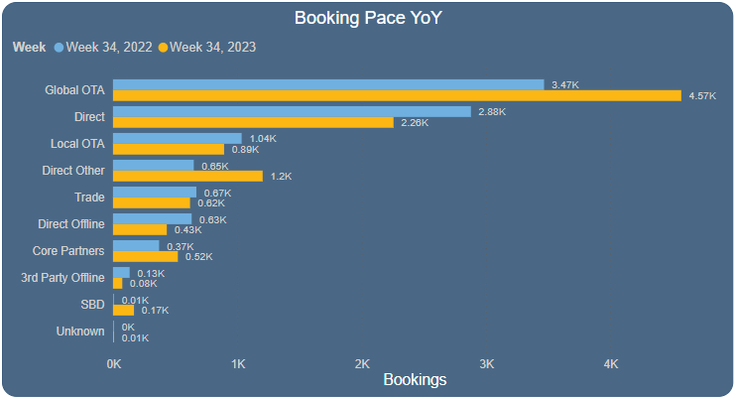
Bookings - Overview
Booking Pace increased 9.11%
Best performing: Global OTAs
Huge relative increase in SBD
Loss of performance: Call centers (Direct & 3rd Party) and tracked web bookings.
Total bookings YoY change
Negatively affects Direct Share

Slide 8
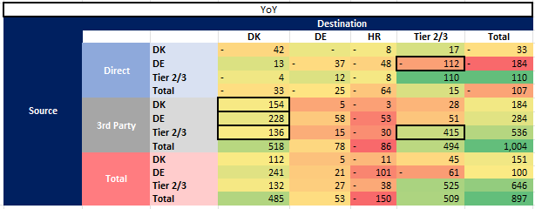
Bookings - Intersects
From source to destination countries
Significant increase in bookings to DK through 3rd Party channels
DE customers shift to 3rd Party channels
HR dropped as a destination from every source country!
Booking intersects YoY change

Slide 9
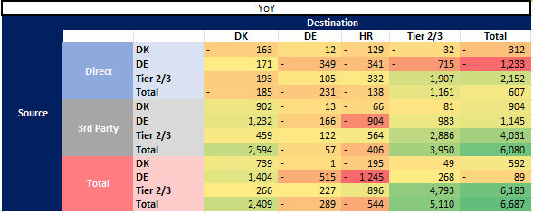
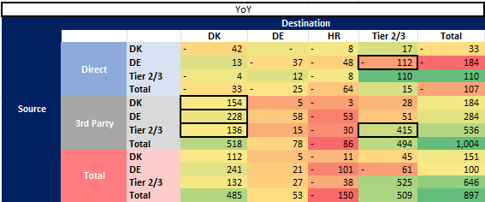
Revenue
Booking deviations should be interpreted with revenue to have a clear picture.
9.16 % Increase in revenue!
Fewer Direct bookings BUT! revenue actually increased – potentially fewer but more expensive bookings
HR decline still present
DE declined as a destination as well, despite the growth in bookings.
Why do customers book fewer trips to HR, and why do they spend less money in DE despite more bookings?
Revenue YoY change
Bookings YoY change

Slide 10
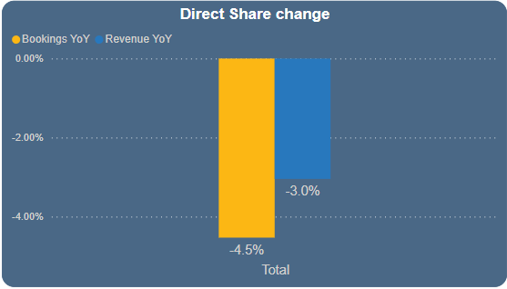
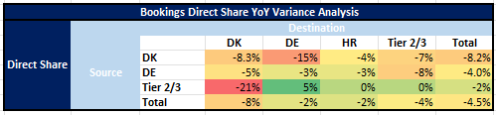
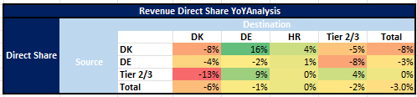
Direct Share
Both bookings and revenue DS dropped since last year
Key take aways:
Shift of All source - DK bookings to 3rd Party
Despite DK customers booked fewer trips to DE, they spent more money.
What causes the All source - DK shift to 3rd Party channels?

Slide 11
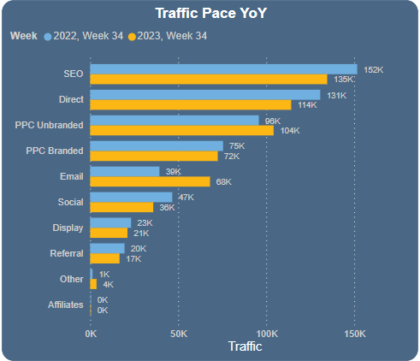
Traffic – CVR
All countries
Must be interpreted together!
Fewer bookings from tracked online sources.
  Loss of traffic and CVR
SEO brings most traffic
Regardless traffic loss, Referral increased conversion rate – sign of optimization
Look at each source country individually. Introduce weighted metric that takes into account the nr. of bookings made.
Total traffic YoY change
Total CVR YoY change

Slide 12
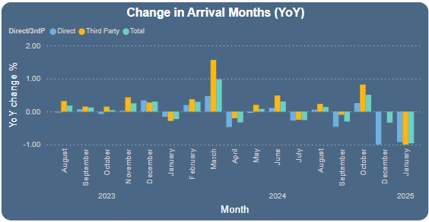
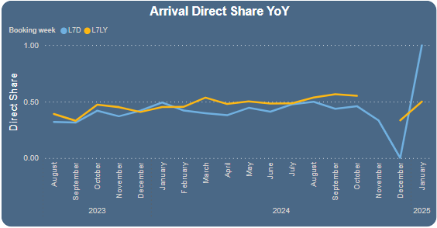
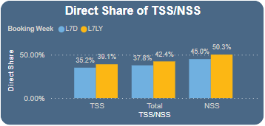
Arrival months
Positive trend Year on Year
3rd Party booking growth almost always exceeds Direct
Direct Share of arrival months also declining tendency
  Visible from TSS/NSS Direct Share change

Slide 13
Summary
Direct Share of Travel Company has dropped in almost every metric
Customers shift from using Direct Channels to 3rd Party
BUT! Revenue is increaseing
  What matters: what brings more revenue to the company
Does it make sense profit-wise to focus on increasing Direct Share?

Slide 14
Suggestions
Investigate what causes the decline in HR and DE as destinations, and the shift of bookings to 3rd Party channels.
Introduce weighted metric for traffic channel evaluation.
Establish key metrics and automate at least some parts of the weekly reporting, so there is more time for the deeper level analysis.

Slide 15
Thank you for your attention!
Do you have any questions?

